Slide 1


SOA & ESB
Laurie Mailloux
Web 420
Presentation 7.2 Service-oriented architecture and enterprise service bus

Slide 2

What is Service-oriented architecture
Service-Oriented Architecture (SOA) is an architectural approach in which applications make use of services available in the network. In this architecture, services are provided to form applications, through a communication call over the internet.
SOA allows users to combine a large number of facilities from existing services to form applications.
SOA encompasses a set of design principles that structure system development and provide means for integrating components into a coherent and decentralized system.
SOA based computing packages functionalities into a set of interoperable services, which can be integrated into different software systems belonging to separate business domains.

Slide 3
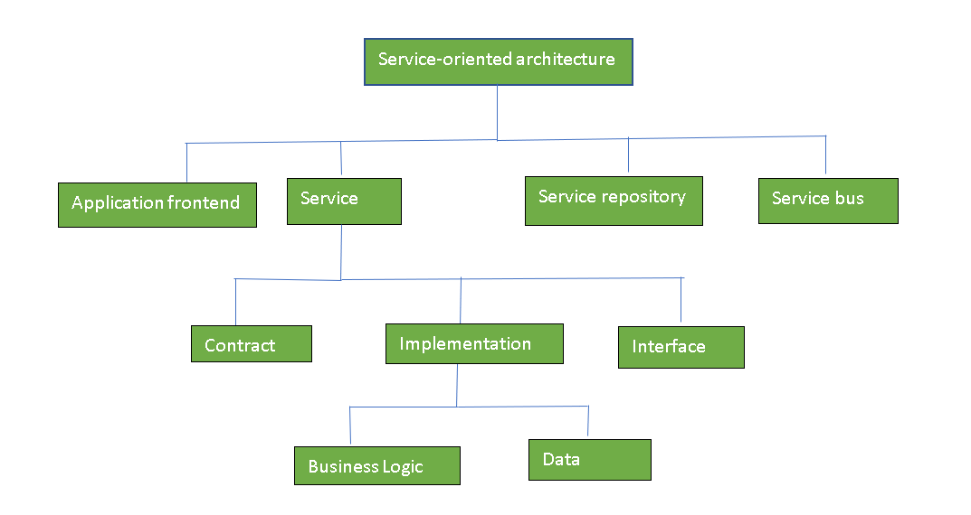
Components of Soa

Slide 4
Advantages of SOA
Service reusability: In SOA, applications are made from existing services.Thus, services can be reused to make many applications.
Easy maintenance: As services are independent of each other they can be updated and modified easily without affecting other services.
Platform independent: SOA allows making a complex application by combining services picked from different sources, independent of the platform.
Availability: SOA facilities are easily available to anyone on request.
Reliability: SOA applications are more reliable because it is easy to debug small services rather than huge codes
Scalability: Services can run on different servers within an environment, this increases scalability

Slide 5
Disadvantages of soa
High overhead: A validation of input parameters of services is done whenever services interact this decreases performance as it increases load and response time.
High investment: A huge initial investment is required for SOA.
Complex service management: When services interact they exchange messages to tasks. the number of messages may go in millions. It becomes a cumbersome task to handle a large number of messages.

Slide 6
What is enterprise service bus
An ESB, or enterprise service bus, is a pattern whereby a centralized software component performs integrations to backend systems (and translations of data models, deep connectivity, routing, and requests) and makes those integrations and translations available as service interfaces for reuse by new applications. The ESB pattern is typically implemented using a specially designed integration runtime and toolset that ensure the best possible productivity.

Slide 7
SOA Service Oriented Architecture
Reusability of services in other applications
Easy to update and maintain
Greater reliability and fewer software errors
Location independent
Scalable and available
Platform independence
ESB Enterprise Service Bus
Less customization required
Consistency and good practice in application integration
Boost operational efficiency and agility by consolidating apps
Wide selection of tools
Easier operational support due to transparency

Slide 8
Deployment and management
Service oriented architecture implementation framework inclues software functionality such as –
Modeling
Integration
Tools
Management
Security
processes

Slide 9
How data is transmitted through a soa environment
Consumer interface layer
Business process layer
Services
Operational systems
Integration layer
Quality of service
Informational
Governance

Slide 10
SOA and Scalability
Properly estimating usage patterns.
Managing user authentication/authorization.
Managing session state (where applicable).
Scaling customer or internal-facing web sites.
Scaling data resources.
Scaling CPU load.

Slide 11
References
Sarthak, Garg. Geeksforgeeks retrieved on June, 2020 from https://www.geeksforgeeks.org/service-oriented-architecture/
IBM cloud education. July 18, 2019 EBS(enterprise service bus) retrieved on June 14, 2020 from https://www.ibm.com/cloud/learn/esb
Anderson, Robert. October 5, 2006 scaling soa with distributed computing. Retrieved on June 14, 2020 from https://www.drdobbs.com/web-development/scaling-soa-with-distributed-computing/193104809

